Slide 1
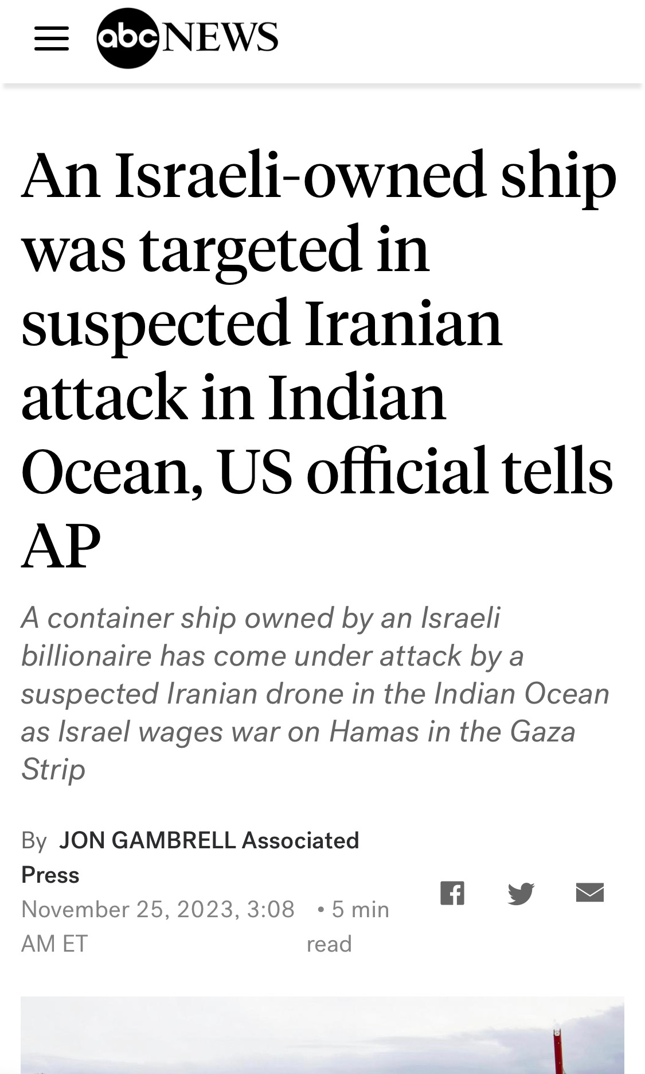
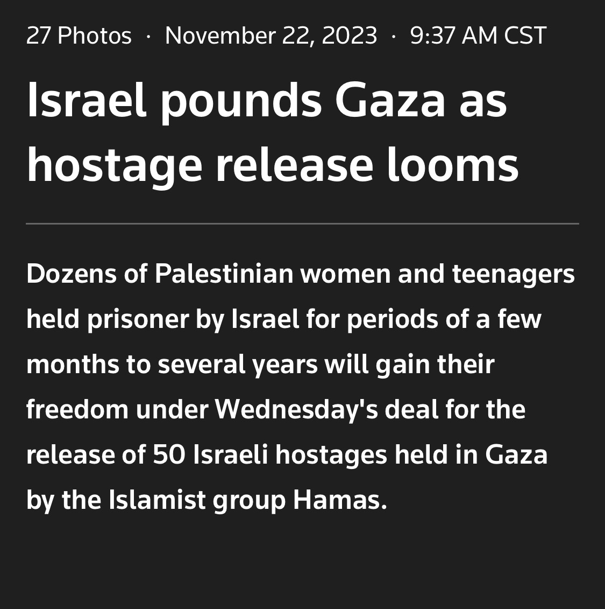

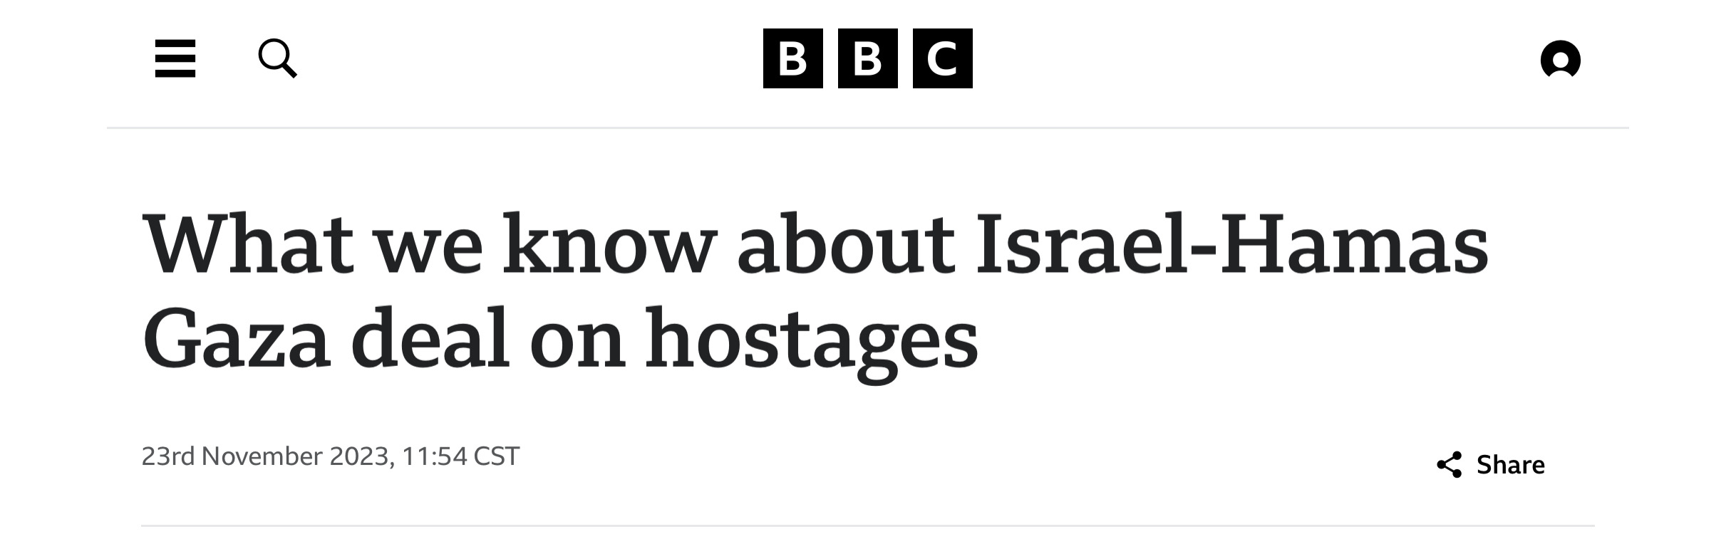
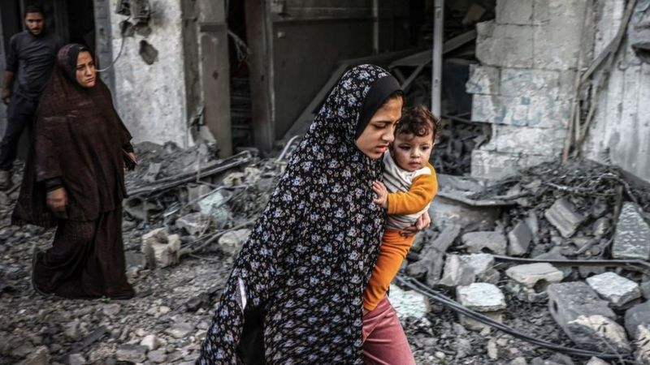
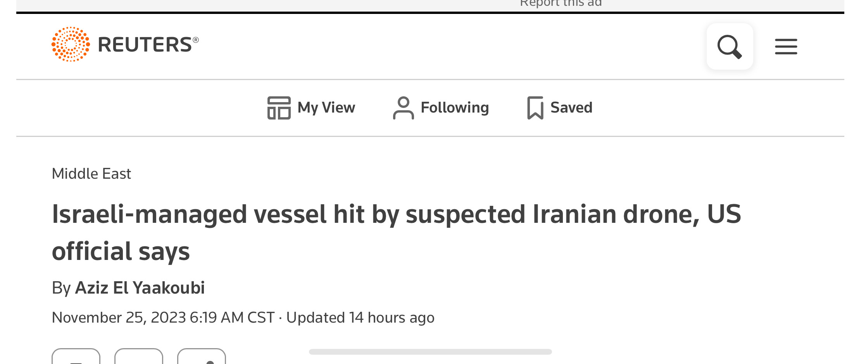

Slide 3


Slide 4


Slide 5


Slide 6


Slide 7


Slide 8


Slide 11

ISRAEL (17,24)

Slide 12
ISRAEL (17,24)
Righteousness in Christ (17-18)

Slide 13


Unbelieving Israelites (20)
ISRAEL

Slide 14

ISRAEL
Believing Gentiles (17)

Slide 15
Individual Israelites grafted back in with Gentile
Christians
(23)
ISRAEL

Slide 16


